Slide 1

Fraud Detection System - Group 10
Banks deal with vast amounts of transactions
Data Complexity and volume
Difficult managing , process and analyze transactions
By: Ullal Atul Nayak
Sharanya Chikke Gowda

Slide 2





Problem Statement
Real-time Detection
Use predictive ML model, and analytics using SQL & Python
High Transaction
Higher loss due to fraud activities
Reduce false positive (Cust feedbacks)

Slide 3



Overview of Fraud Detection System
Adaptive threat response mechanisms to adjust its fraud detection strategies based on evolving threats.
Customer feedbacks incorporated in ML model
Real-time Monitoring using Fraud Detection ML Model

Slide 4
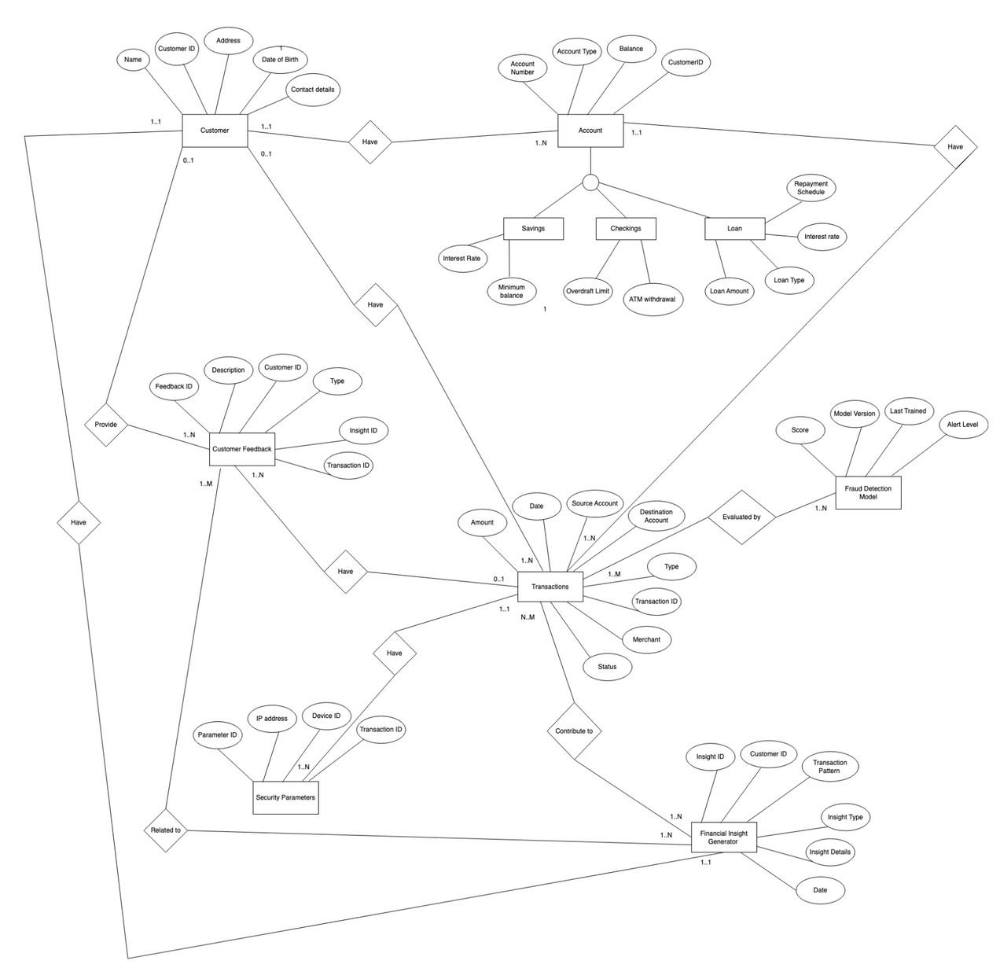
EER Diagram

Slide 5

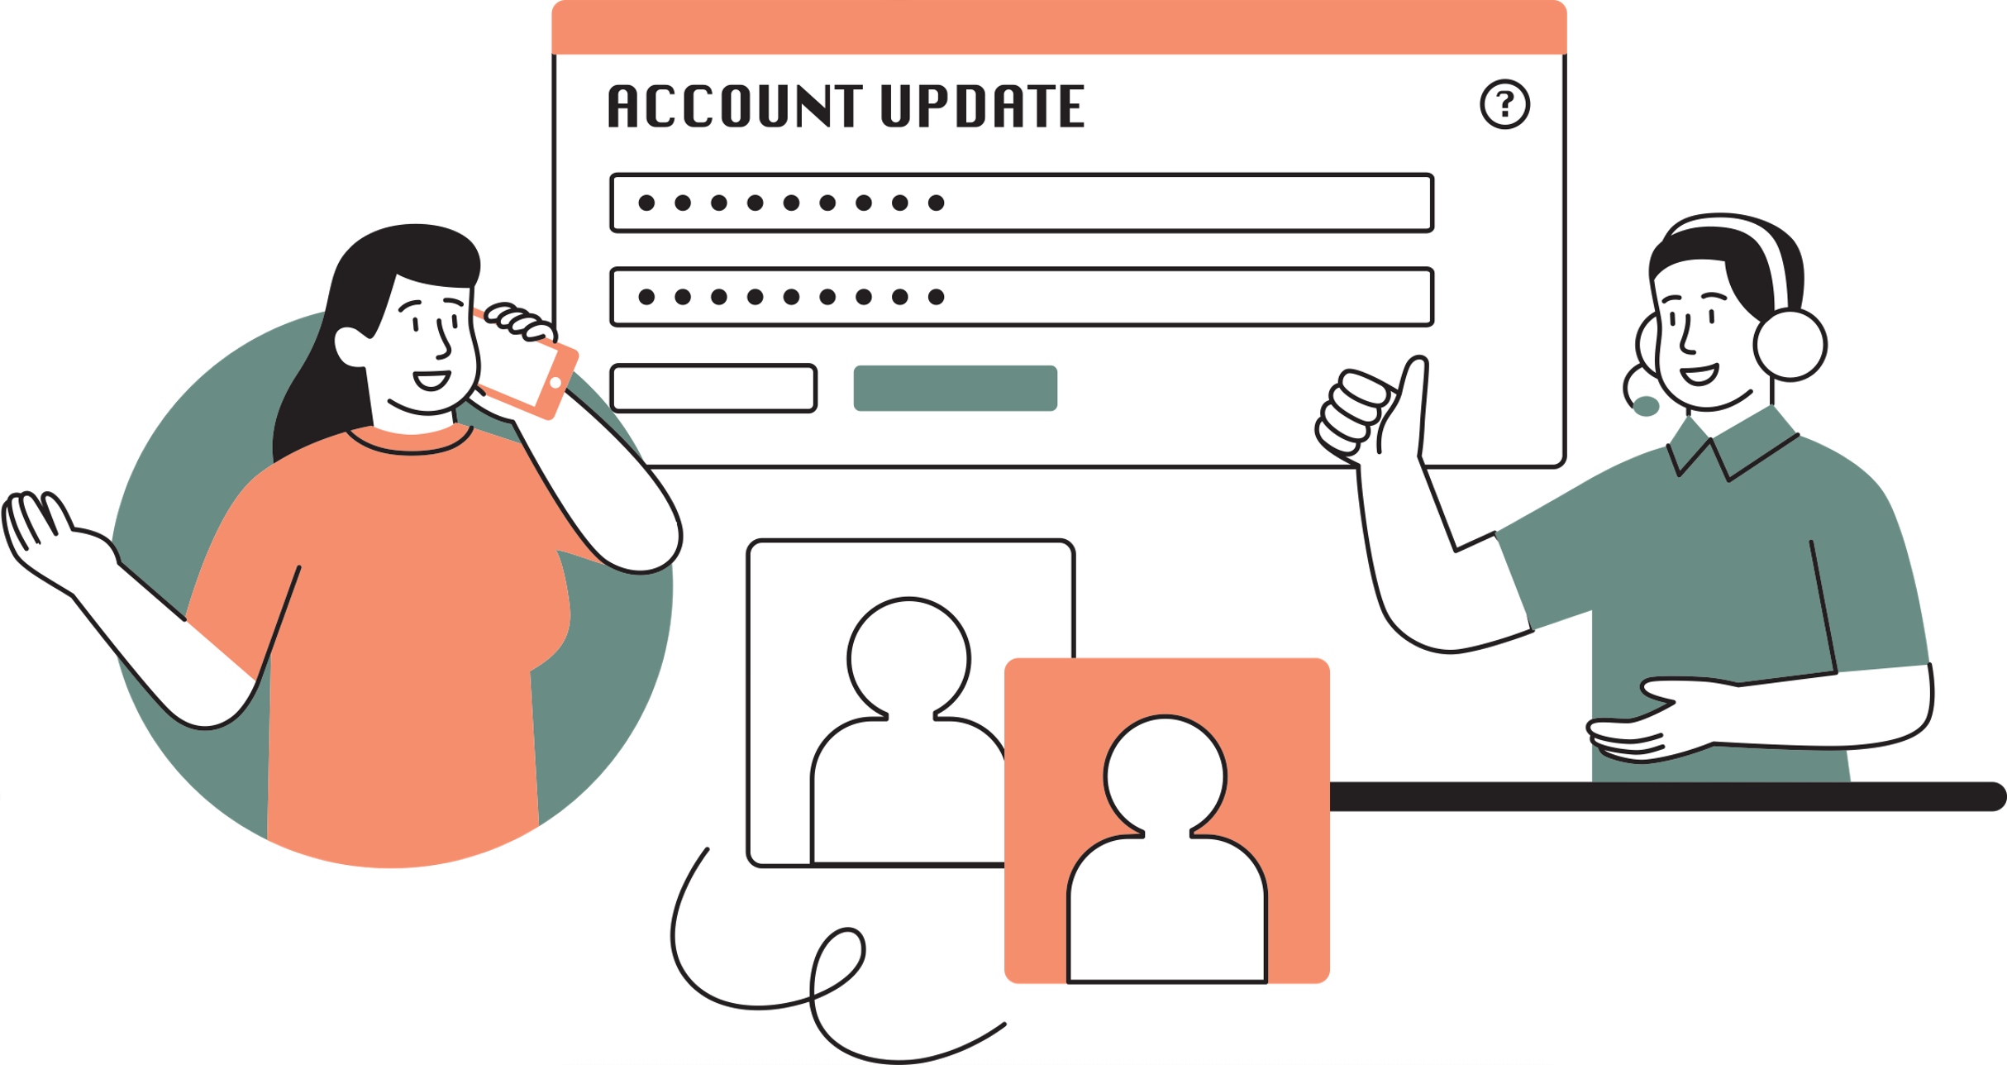
Scope and Objectives of Analytics
Customer and Account entities at the core of the database.
Fraud Detection Model to evaluate transaction patterns.
Real-time monitoring of account balances and transactions to detect anomalies.
Evaluating the performance of fraud detection models over time.
Gathering insights from customer feedback on flagged transactions.

Slide 6
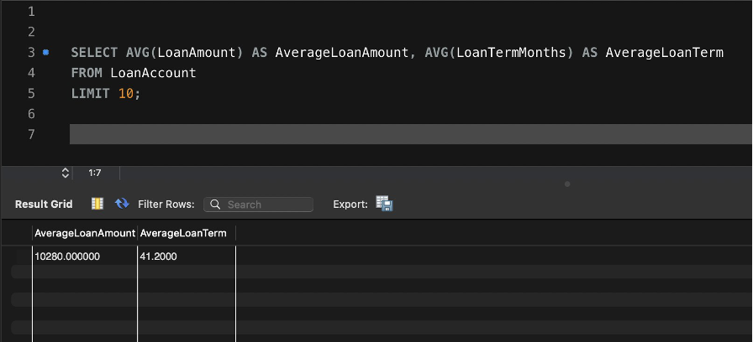
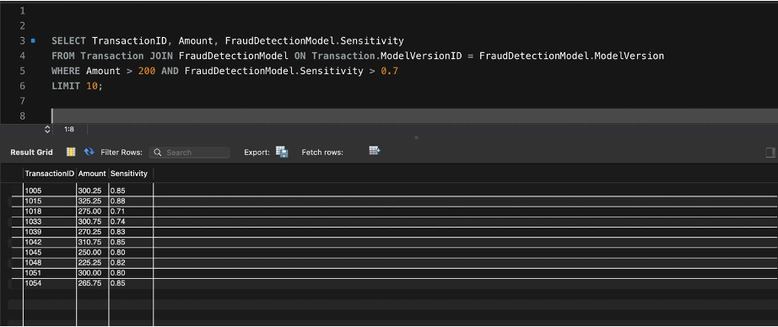
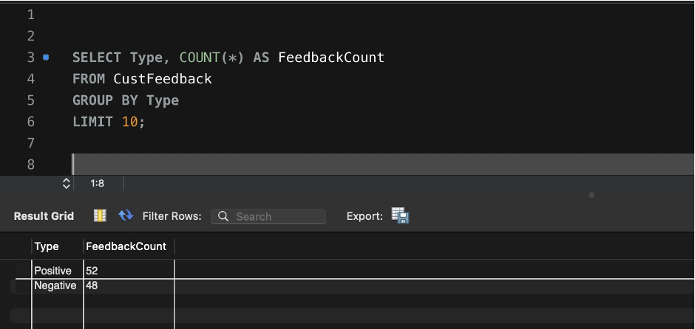
SQL Analytical Queries
Distribution and averages of loan amounts and terms. This can provide insights into the loan products' popularity and the financial behavior of customers taking loans.
Identify transactions that are high Risk Transaction
Analyze the types and frequencies of feedback provided by customers. This feedback can reveal customer satisfaction levels, usability issues, or areas needing improvement in the system.

Slide 7
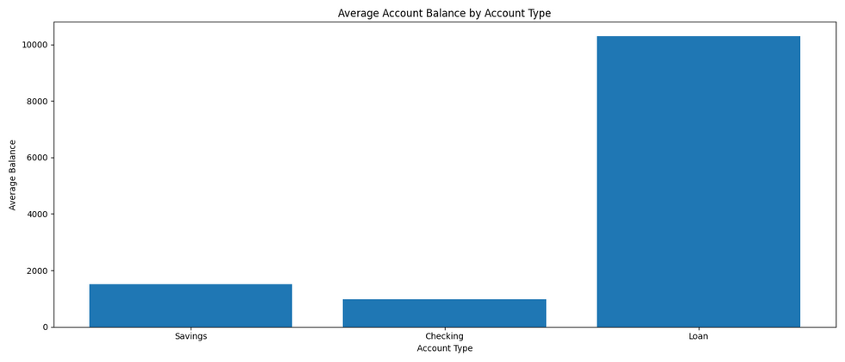
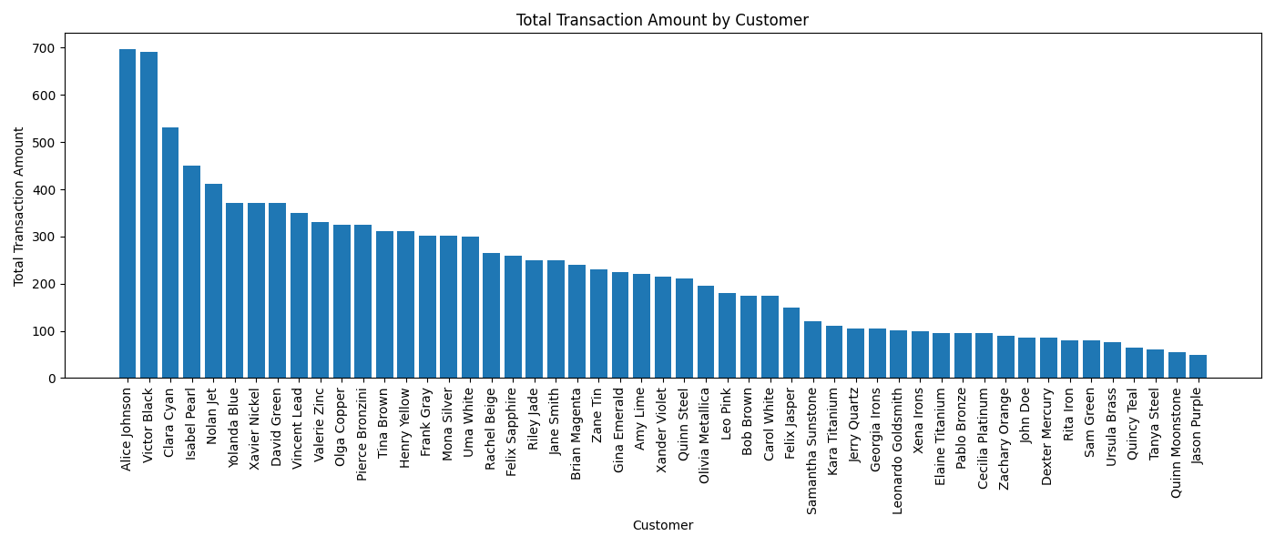
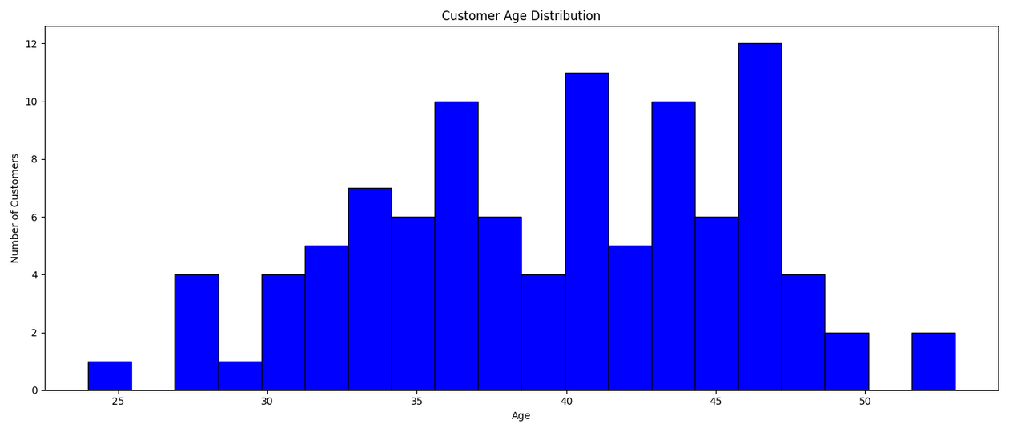
Python Visualization from the Database

Slide 8
Conclusion
We are committed to strengthen Financial Security by integrating Advanced Fraud Detection models

Slide 9
Thank you!

